Slide 1
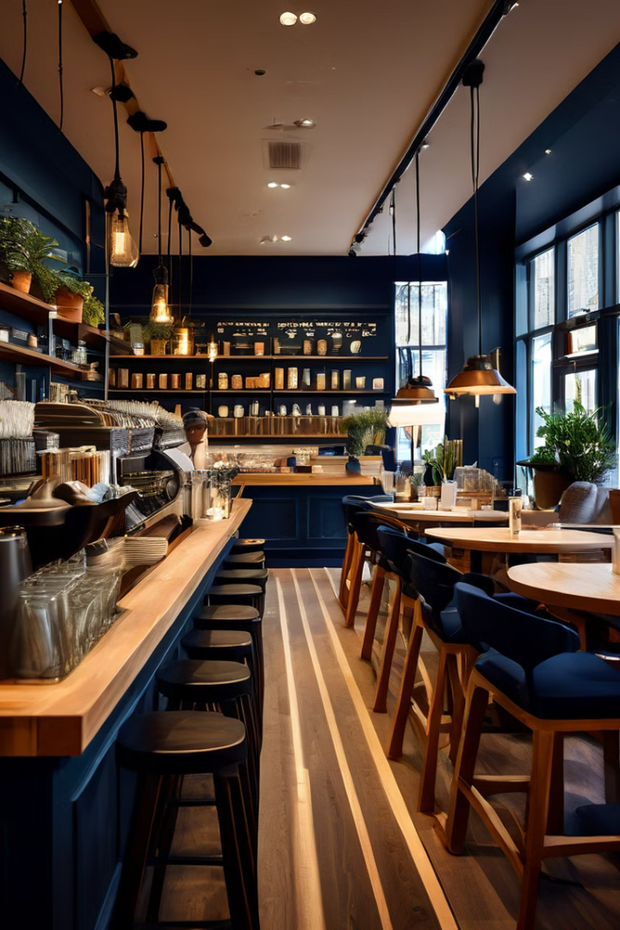
Introduction to the Coffee Shop Application
Welcome to our innovative coffee shop application, where the art of crafting the perfect cup of coffee meets the convenience of modern technology. This application is designed to revolutionize the way customers experience their favorite beverage, offering a seamless and personalized ordering process that caters to their unique preferences.
SA

Slide 2

Project Objectives and Scope
1
Enhance Customer Experience
2
Streamline Order Management
Our primary objective is to create a user-friendly interface that empowers customers to customize their coffee orders with a wide range of condiments, ensuring they receive their perfect beverage every time.
The application will also focus on optimizing the order management process, allowing baristas to efficiently fulfill orders and provide timely service to customers.
3
Foster Loyalty and Engagement
By offering a seamless and personalized ordering experience, we aim to build a loyal customer base and foster a strong sense of community within the coffee shop.

Slide 3
Core Features of the Application
Customizable Orders
Order Tracking
Loyalty and Rewards
Customers can easily build their perfect cup of coffee by selecting from a variety of coffee sizes, roasts, and condiments, including milk, syrups, and toppings.
Customers can track the status of their order in real-time, from the moment they place it to when it's ready for pickup or delivery.
The application will feature a loyalty program, allowing customers to earn rewards and redeem them for future purchases, fostering customer engagement and retention.

Slide 4
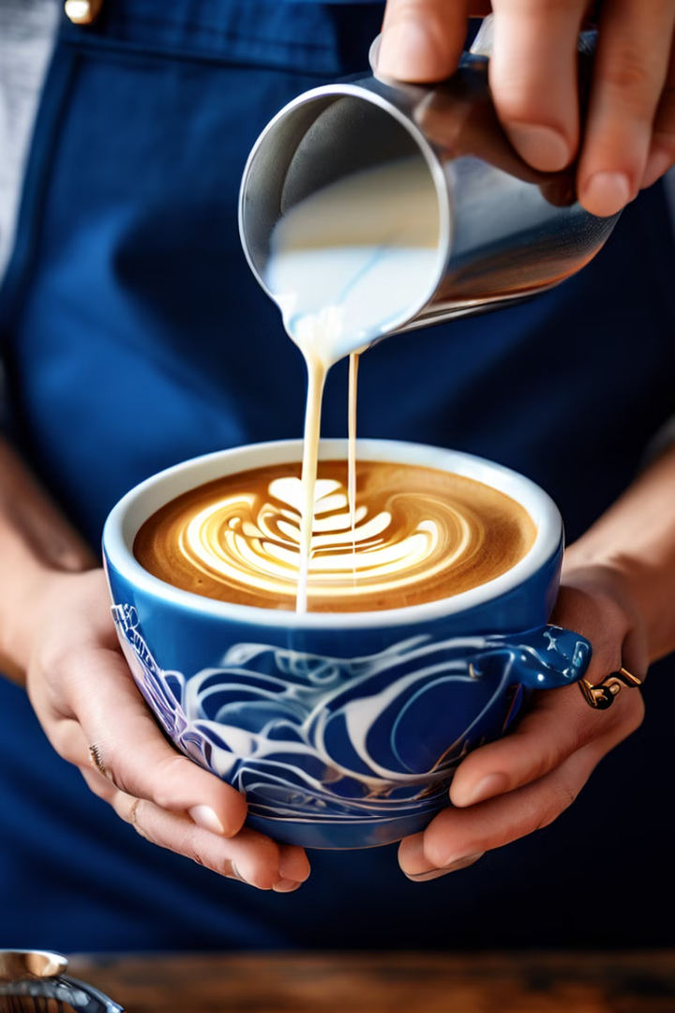
Customizing Coffee Orders with Condiments
1
Milk Choices
Customers can select from a variety of milk options, including whole, skim, almond, and soy, to create their perfect coffee drink.
2
Syrup Flavors
The application will offer a range of syrup flavors, such as vanilla, caramel, and hazelnut, allowing customers to add a touch of sweetness to their coffee.
3
Toppings and Extras
Customers can further customize their coffee by adding toppings like whipped cream, chocolate shavings, or a shot of espresso, ensuring their drink is tailored to their exact preferences.

Slide 5
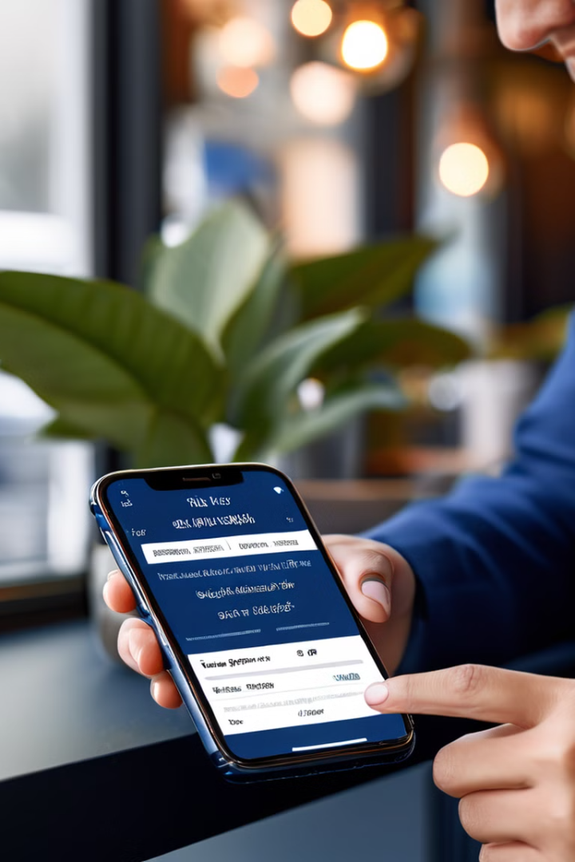
User Interface Design and Functionality
Intuitive Navigation
Visual Representation
The application's user interface will be designed with a focus on intuitive navigation, allowing customers to easily browse the menu, customize their orders, and place their requests with just a few taps.
The interface will feature visual representations of the available coffee sizes, roasts, and condiments, helping customers make informed decisions and visualize their final order.
Saved Preferences
Seamless Checkout
Customers will be able to save their favorite orders and customizations, allowing them to quickly re-order their go-to drinks with a single click.
The checkout process will be streamlined, enabling customers to securely pay for their orders and choose their preferred pickup or delivery option.

Slide 6





Backend Implementation and Data Management
Data Storage
Scalable Infrastructure
The application will utilize a robust and scalable database system to store customer orders, preferences, and transaction history, ensuring secure and efficient data management.
The backend architecture will be designed to handle high-volume traffic and provide reliable, low-latency responses, ensuring a seamless user experience even during peak hours.
Data-driven Insights
Robust Security
The application will leverage data analytics to provide valuable insights into customer behavior, enabling the coffee shop to optimize its offerings and improve the overall customer experience.
The backend will implement industry-standard security measures to protect customer information and ensure the integrity of the application, building trust and confidence in the service.

Slide 7




Testing and Quality Assurance
Unit Testing
The development team will perform rigorous unit testing to ensure the reliability and functionality of individual components within the application.
Integration Testing
The team will also conduct comprehensive integration testing to verify the seamless collaboration between the application's various modules and features.
User Acceptance Testing
Extensive user acceptance testing will be conducted to gather feedback from real-world users and ensure the application meets their needs and expectations.

Slide 8
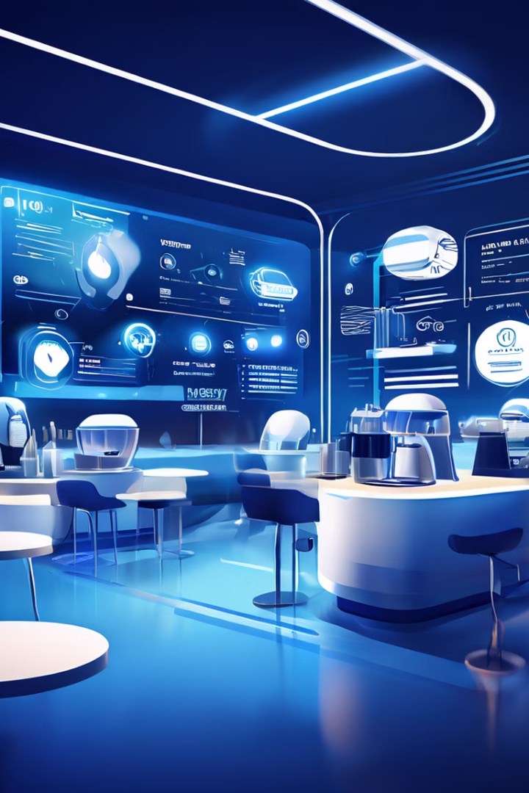
Conclusion and Future Enhancements
In conclusion, the Coffee Shop Application represents a forward-thinking and innovative approach to the coffee industry, empowering customers to craft their perfect beverage while providing a seamless and personalized experience. As the application continues to evolve, we are committed to exploring new technologies, incorporating customer feedback, and delivering a coffee experience that sets the standard for the industry.
Future enhancements may include features like mobile order-ahead, AI-powered recommendations, and integration with smart home devices, further elevating the customer's coffee journey. By staying at the forefront of technology and consumer trends, we aim to position the Coffee Shop Application as the premier destination for coffee enthusiasts everywhere.

